Slide 1
THE METICULOUS ART OF FORMING RESOLUTIONS

Slide 2
WHAT IS A RESOLUTION?
Aims to resolve the issues addressed by a committee.
Formulated through collaborative effort.
Material for debate during moderated caucus.

Slide 3
How to Structure a Resolution
Heading
-Forum, Issue, Countr(ies) sponsoring resolution
Preambulatory Clauses
-Used to show there’s a problem that needs to be solved and what has been done to solve it (does not introduce solutions)
-Remember to represent the views of the sponsors
-Includes references to UN documents
Operative Clauses
-Highlight what the country wants to achieve with this resolution

Slide 4
Sample Resolution

Slide 5
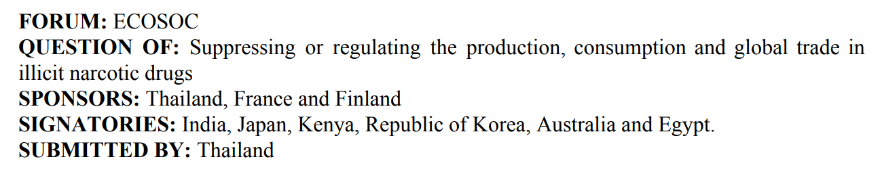
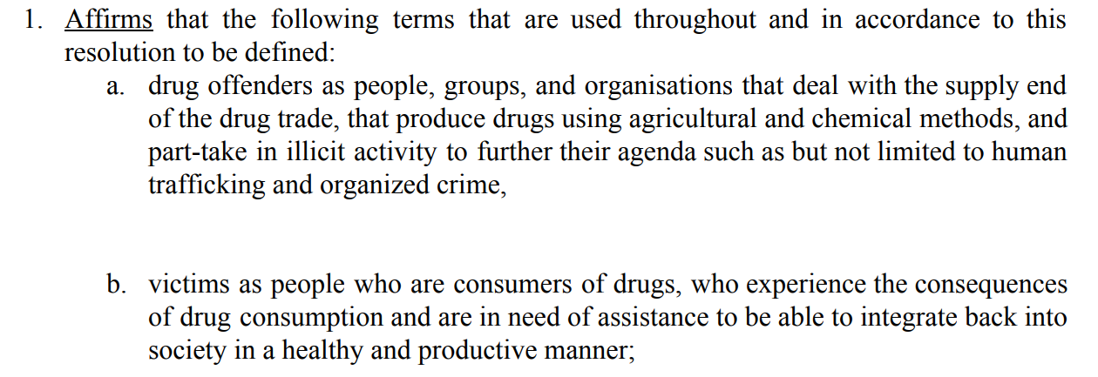

Slide 6
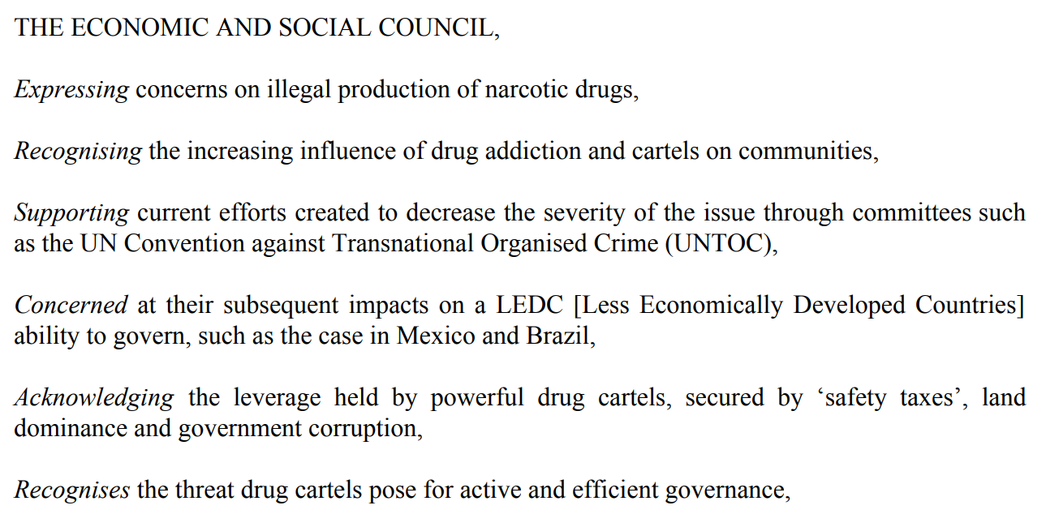

Slide 7
A Reminder on Key Words

Slide 8
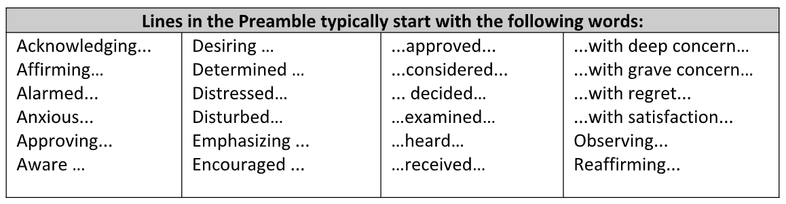
Preambulatory Starters

Slide 9
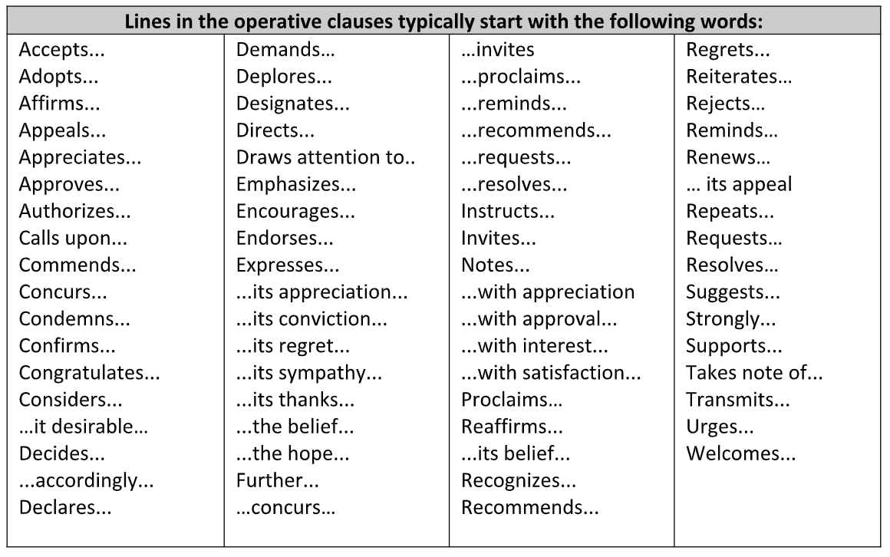
Operative clause starters

Slide 10
Sponsor(s) and signatories
The main author(s) of a resolution, who will submit the document to their Chairs.
Delegates who would like to see the resolution debated further in the Council
Notes:
Resolution
Sponsor - main authors of a resolution who
Signatories - delegates who would like to see the resolution debated further in the council and don’t necessarily have to agree with the resolution
Amendment - modifications/changes that delegates submit to the Chair for further debate
Preambulatory clauses - phrases that appear in the preamble section of a resolution. Are descriptive
Operative clauses - phrases that express actions sponsors and signatories would like to take in regards to the agenda at hand

Slide 11
Amendments
You will be debating on amendments during the two days of MUN
Amendments are used to modify draft resolutions and can be submitted by sponsors and non-sponsors (friendly vs unfriendly)
For example:
The delegate of _______ proposes to amend operative clause 6 to read “6. Calls upon developed countries to reduce their emissions by 5%...”

Slide 12
How to write a GOOD
resolution
DO’s
DON’TS
Be very specific
Address the issue from more than one angle
Use critical thinking skills
Ask yourself the following
  Will this work?
  What are the logistics?
  How will it be funded?
  Why would a country disagree/ vote against this?
Repeat existing UN legislation
Go against your own country
Sponsor a resolution you haven’t helped write
Offer surface level solutions
Suggest things your council doesn’t have the power to do

